Slide 1
Determining which Aircratf are the Lowest Risk for the Company to start a new Business endeavor
Rodgers Otieno

Slide 2
Introduction
The analysis aims to assess
safety and
operational risks
across different aircraft models to help the company choose low-risk airplanes for its new aviation business.

Slide 3
Business Understanding
Organization needs to diversify
Need to acquire and manage commercial and private aircrafts
Be aware of the related Risks
Goal: Find aircrafts with lowest risks

Slide 4
Understanding the Data
Aircraft.Damage - determines how severe the accidents were which closely related
Total.Fatal.Injuries, TOtal.Serious.Injuries, Total.Minor.Injuries - Safety
Aircraft.Category – threshold of risk
Make, Model - Helps in analysziing Trends
Engine.Type - safety records
Weather.Condition -if adverse weather conditions plays a role
Broad.phase.of.flight – landing, takeoff or cruising

Slide 5
Analysis

Slide 6
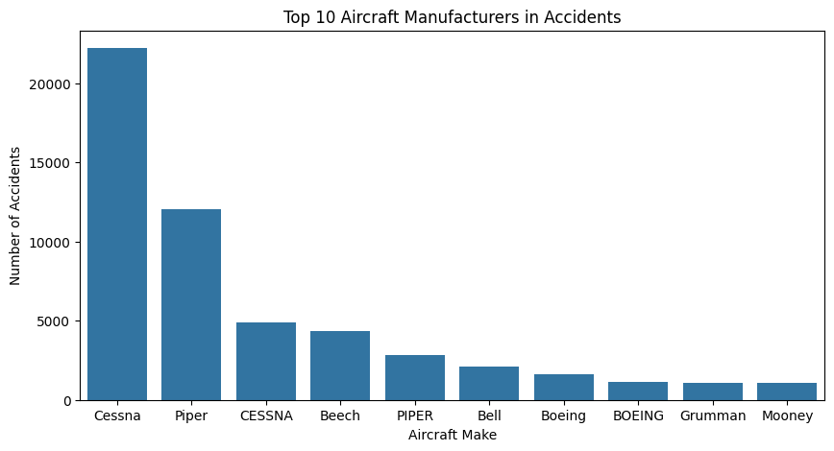
1. The Most Common Aircraft Makes that are prone to accidents
The graph shows that Cessna, Piper, and Beech recorded over 2000 accidents, therefore they are the most common aircrafts.

Slide 7
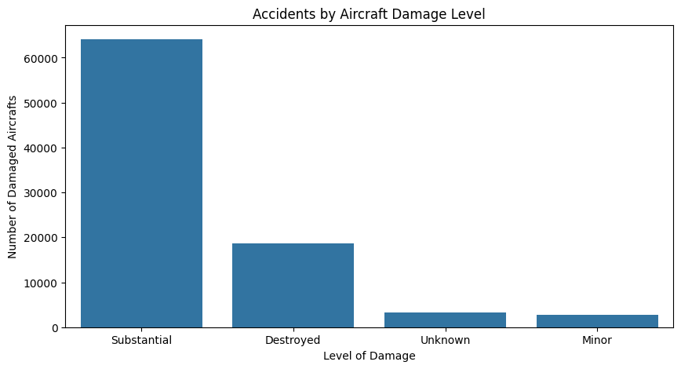
2. Level of Damage of an Aircraft after an accident
Majority of the aircrafts ended in substantial damages. On the other hand not all were totaly damaged while very few had minor damages.

Slide 8
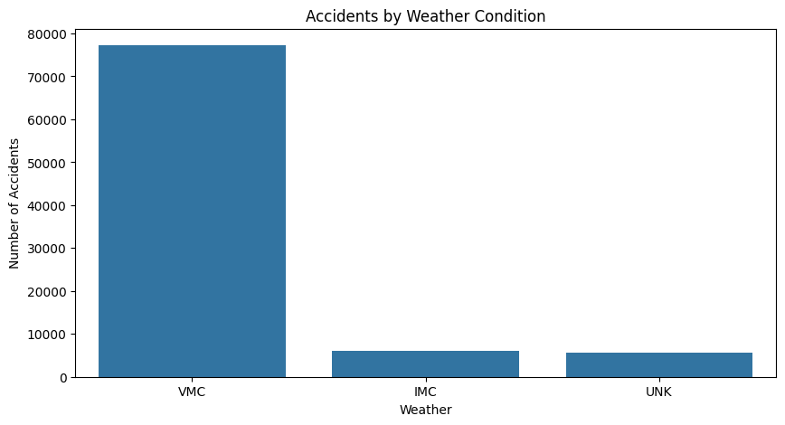
3. Impact of Weather on Accidents
Many accidents are experienced during Visual Meteorological Condition (VMC)

Slide 9
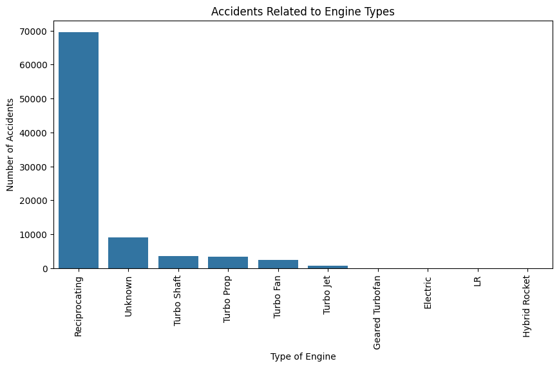
4. Accidents by Engine Types
- Reciprocating Engines caused the most number of accidents
- Small piston planes use reciprocating engine while Turbofan and Turbo Jet Engines are used in business jets.

Slide 10
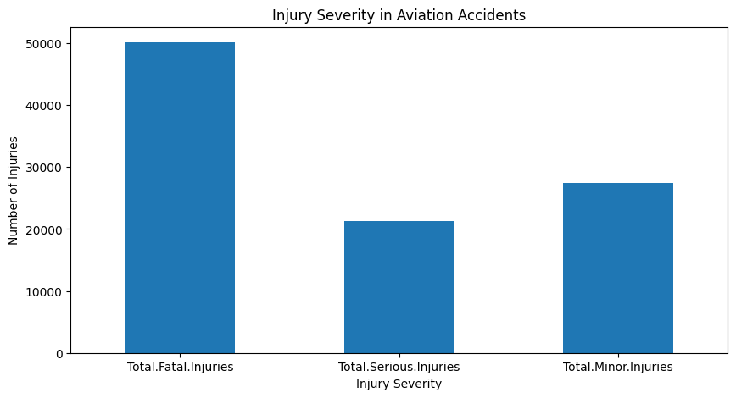
5. Analysis by Injury Severity
Most Accidents resulted into Total Fatal Injuries

Slide 11
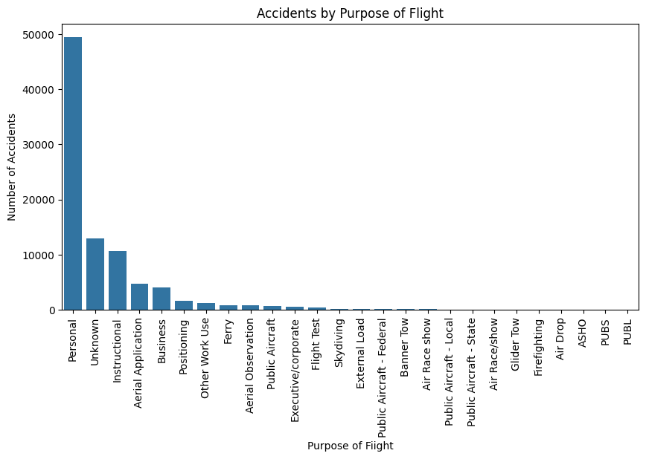
6. Analysis by Pupose of Flight
More accidents are experienced when the purpose is to fly the aircraft personally.
This could be associated to the fact that private pilots are not professional and tend to fly casually and carelessly

Slide 12
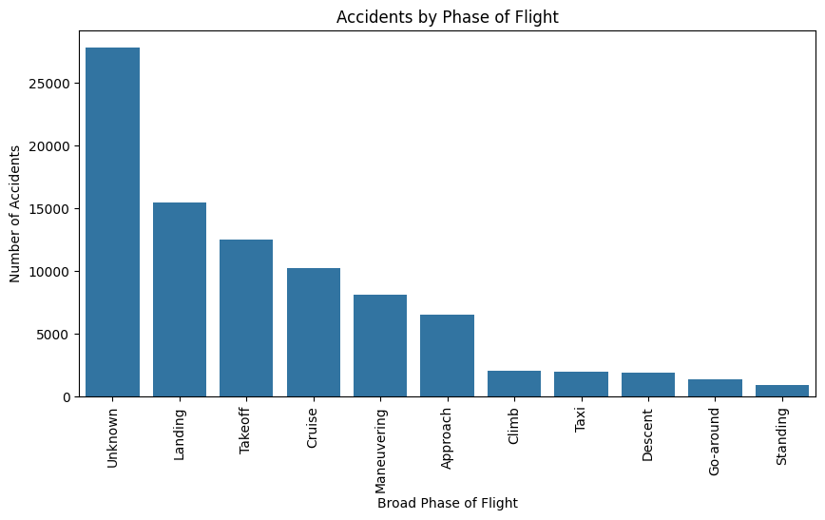
7. Analysis by Phase of FLight
Majority of the accidents occur during takeoff and landing

Slide 13
Recommendation 1
- Turbofan Engines which are mostly used for commercial aircrafts caused fewer accidents compared to reciprocating which are primarily piston based and commonly used for small jets.
Therefore the organization should consider Purchasing Turbo Engines. On the other hand Engines like Electric and LR and Hybrid Rocket recorded low accidents. They caould also be considered

Slide 14
Recommendation 2
It is important to know that many accidents in the aviation sector occur during landing and takeoff.
This means that the organization should consider training their pilots frequently not only on safety procedures but also proficiency and keenness.

Slide 15
Recommendation 3
More accidents are experienced when the purpose is to fly the aircraft personally.
This could be associated to the fact that private pilots are not professional and tend to fly casually and carelessly.
The organization should enact rules that will allow private customers to be flown by a professional pilot provided by the organization.

